Slide 1
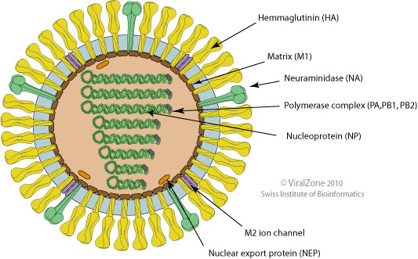

Orthomyxoviruses
Dr. CHHAY Sokdalis

Slide 2
Objectives
Illustrate structure and replication of orthomyxovirus.
Describe the pathogenesis of orthomyxovirus infection.
Describe the immune against orthomyxovirus.
Explain how orthomyxovirus transmitted.
Describe the clinical manifestations orthomyxovirus.
List the techniques for detecting orthomyxovirus.
Describe the treatment of orthomyxovirus.

Slide 3
Introduction
Influenza A, B, and C viruses only members of Orthomyxoviridae family, only influenza A and B viruses→human disease.
Enveloped, segmented (-)RNA→development of new strains (mutation and reassortment).
Most prevalent and significant viral infections.
Cause respiratory symptoms and classic flulike symptoms (fever, malaise, headache, and myalgias (body aches)).

Slide 4
Structure
Pleomorphic, spheric or tubular (helical) diameter 80-120 nm.
Envelope: 2 glycoproteins (hemagglutinin (HA) and neuraminidase (NA)), membrane (M2) protein and is internally lined by matrix (M1) protein.
Genome: ss 8 segmented (-)RNA (RNA +nucleoprotein (NP)+ transcriptase (RNA polymerase: PB1, PB2, PA), 890-2340 bases.
HA: attachment protein→fusion of envelope to cell membrane and protective neutralizing Ab response.
NA: cleaves sialic acid on glycoproteins→prevents clumping and facilitates release of virus from infected cells
M1, M2, and NP proteins: type specific (differentiate influenza A, B or C).
M1 protein: promote assembly.
M2 protein: promotes uncoating and viral release.

Slide 5
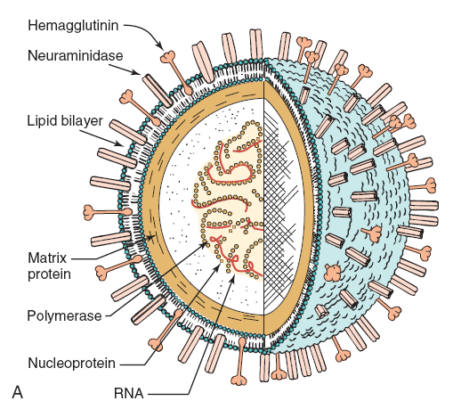
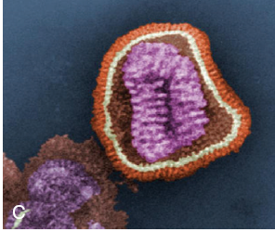
Structure

Slide 7
Replication
Attachment: HA to sialic acid on cell surface glycoproteins.
Penetration: receptor-mediated endocytosis (internalized into a coated vesicle→endosome→viral envelope fuses with endosome membrane).
Uncoating: break interaction between M1 protein and NP→delivery of nucleocapsid→cytoplasm→nucleus.
Transcription: mRNA, transcriptase (PA, PB1, and PB2) uses host cell mRNA as a primer for viral mRNA synthesis→ Translate (proteins).
Replication: (+)RNA templates→(-)RNA genome (nucleus).
Release: bud plasma membrane.
Virus is released approximately 8 h after infection.

Slide 8
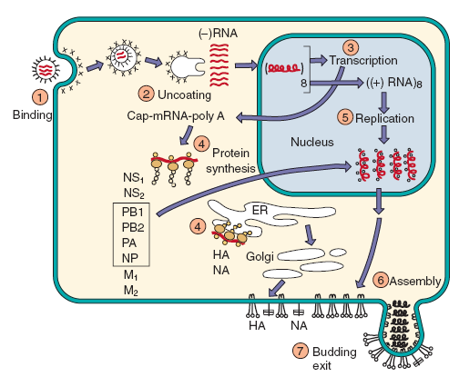
Replication

Slide 9
PATHOGENESIS AND IMMUNITY
Virus can establish infection of upper and lower respiratory tract.
Systemic symptoms: interferon and cytokine response to virus. Epithelial cell damage→local symptoms .
Interferon and cell-mediated immune (natural killer and T cells)→immune resolution and immunopathogenesis.
Infected people are predisposed to bacterial superinfection because of loss of natural barriers and exposure of binding sites on epithelial cells.
HA and NA of influenza A virus can undergo major (reassortment: shift) and minor (mutation: drift) antigenic changes to ensure presence of immunologically naïve, susceptible people.
Influenza B virus undergoes only minor antigenic changes.

Slide 10
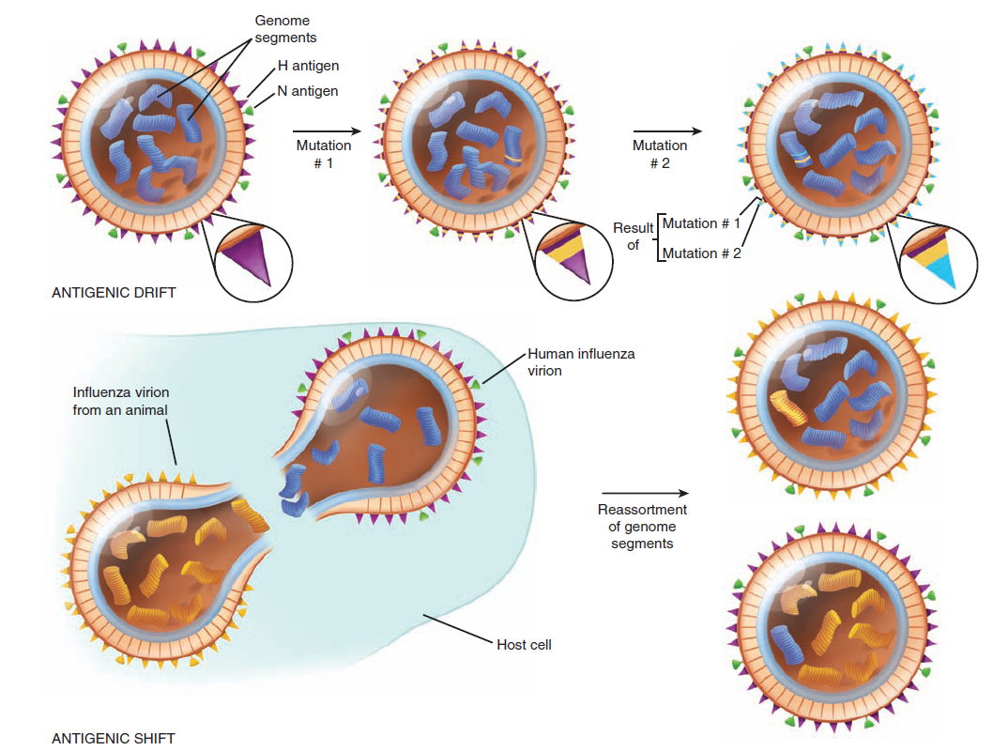

Slide 12
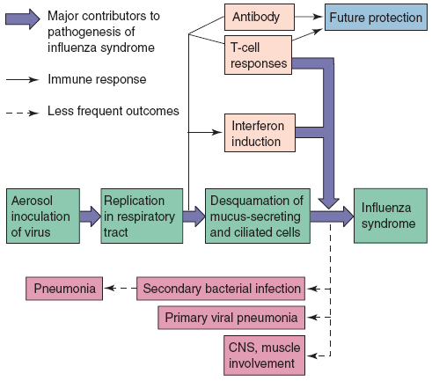
PATHOGENESIS AND IMMUNITY

Slide 13
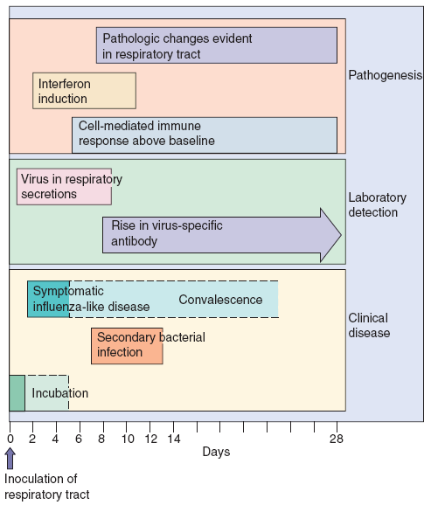
PATHOGENESIS AND IMMUNITY

Slide 14
EPIDEMIOLOGY
Disease/Viral Factors
Large, enveloped virion→inactivated by dryness, acid, and detergents.
Segmented genome→major genetic changes (hemagglutinin and neuraminidase proteins).
Influenza A infects many vertebrate species, including other mammals and birds.
Co-infection with animal and human strains of influenza→very different virus strains by genetic reassortment.
Transmission of virus often precedes symptoms.
Influenza A virus causes more severe disease and more widespread epidemics than does influenza B virus.
Transmission
Inhalation of small aerosol droplets (<10µm) (talking, breathing, and coughing).
Virus likes a cool, less humid atmosphere (e.g., winter heating season).
Virus is extensively spread by school children

Slide 15
EPIDEMIOLOGY
Who Is at Risk?
Seronegative people.
Adults: classic flu syndrome.
Children: asymptomatic to severe respiratory tract infections.
High-risk groups: elderly and immunocompromised people, people in nursing homes or with underlying cardiac or respiratory problems (asthma and smokers).
Geography/Season
Worldwide occurrence: epidemics (local); pandemics (worldwide).
Disease is more common in winter (October-May).
Modes of Control
Prophylaxis or early treatment: Amantadine, rimantadine, zanamivir, and oseltamivir.
Killed and live vaccines contain predicted yearly strains of influenza A and B viruses

Slide 16
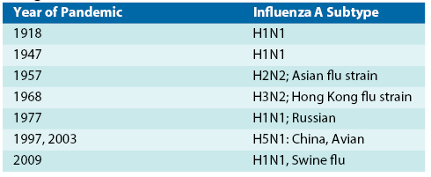
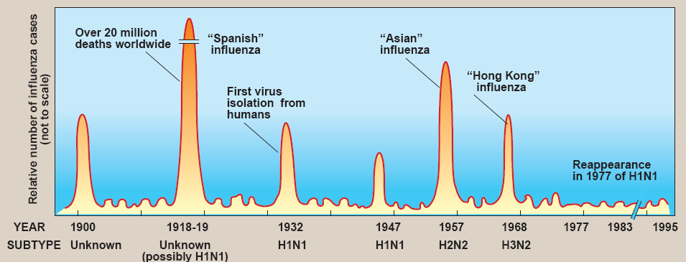
EPIDEMIOLOGY

Slide 17
CLINICAL SYNDROMES
Incubation period: 1-4 days (18-72h)
Flu syndrome (prodrome): malaise, headache, fever, chills, severe myalgias, loss of appetite, weakness and fatigue, sore throat, and usually a nonproductive cough.
Fever persists for 3-8 days, and unless a complication occurs, recovery is complete within 7-10 days.
Young children: bronchiolitis, croup, otitis media, vomiting, and abdominal pain, accompanied rarely by febrile convulsions.
Complications: bacterial pneumonia, myositis, and Reye syndrome→central nervous system.
Influenza→pneumonia or secondary bacterial superinfection→bronchitis or pneumonia (purulent sputum).

Slide 18
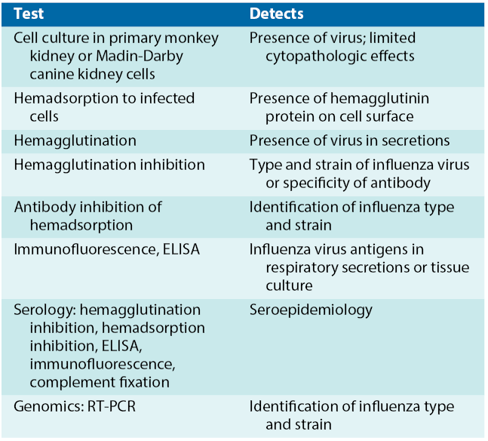
LABORATORY DIAGNOSIS

Slide 19
TREATMENT, PREVENTION, AND CONTROL
Amantadine and rimantadine inhibit an uncoating step of influenza A virus but do not affect influenza B and C viruses.
Zanamivir and oseltamivir: inhibitors of neuraminidase→influenza A and B→prophylaxis and treatment.
Vaccine: >50 years, health care workers, pregnant women, nursing home, chronic pulmonary heart disease, children.
Trivalent form: A, B & C ; both inactivated (killed) and live attenuated vaccines.

Slide 20
Reference
Patrick R. Murray, Ken S. Rosenthal, Michael A. Pfaller. MEDICAL MICROBIOLOGY. 2013. 7th EDITION.
Cynthia Nau Cornelissen, Bruce D. Fisher, Richard A. Harvey, Lippincott’s Illustrated Reviews: Microbiology. Third Edition. 2013.
Kenneth J. Ryan, MD, C. George Ray. Sherris Medical Microbiology. 6th edition. 2014.

